Slide 1
CS 4530
Fundamentals of Software Engineering
Module 17: Engineering Software for Equity
Adeel Bhutta, Mitch Wand
Khoury College of Computer Sciences
© 2024 Released under the CC BY-SA license

Slide 2
Learning Goals
By the end of this lesson, you should be able to…
  Illustrate how software can cause inadvertent harm or amplify inequities
  Explain the role of human values in designing software systems
  Explain some techniques that software engineers can use in producing software systems that are more congruent with human values.

Slide 3
Ethically and morally implicated technology is everywhere!
Algorithms that gate access to loans, insurance, employment, government services…
Algorithms that perpetuate or exacerbate existing discrimination
Bad medical software can kill people (Therac-25)
UIs that discriminate against differently-abled people (Domino's)
Third-party data collection for hyper-targeted advertising
GPT-3 !!
And on… and on… and on…
Notes:
<Read Slide, with ad lib details as you wish>

Slide 4
A few representative examples
Some of these are old, but things haven't changed…
Notes:
[I haven't updated the speakers notes for this section]

Slide 5
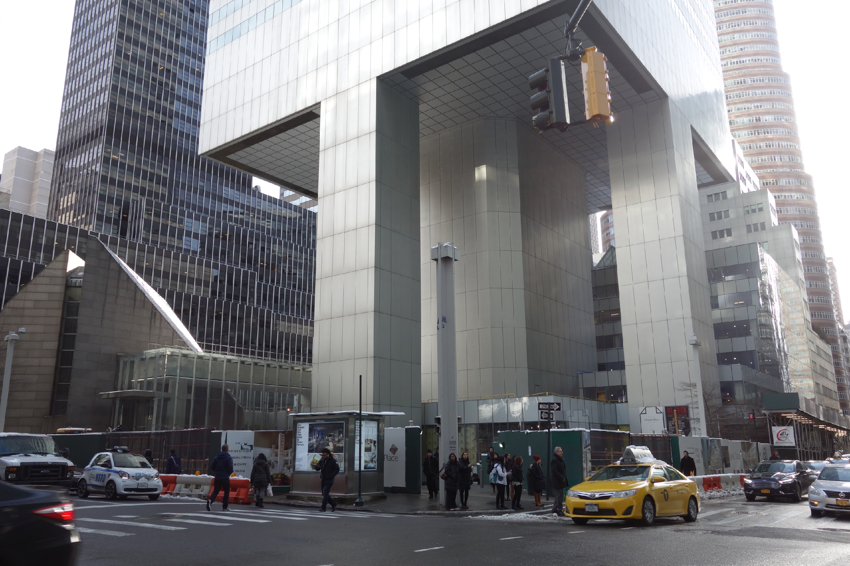
Following regulations alone is not enough
Citigroup Center
Design met building code, but did not account for all failure modes
Last-minute changes to construction increased odds of failure
Fixed before disaster could strike, but kept a secret for 20 years
https://en.wikipedia.org/wiki/Citicorp_Center_engineering_crisis
“Citigroup Center” by Tdorante10, Wikimedia commons, CC BY-SA 4.0
Notes:
Here’s a photo of the bottom of Citigroup Center, which was built 1974. It’s a very interesting building design: a 59 story tower cantilevered over a church - note this unique column architecture supporting the building. The engineer, LeMessurier, created a design that met building code (which in particular, required the design to be resilient to winds from N/S/E/W), but an analysis by an undergrad’s senior thesis found a diagonal hurricane-force wind would quite likely blow over the building. Usually face-on winds are the worst (for a building with columns on corners), but this building had columns in middle! Would have been OK if bottom joints were welded, but steel contractor wanted to bolt them to save millions of dollars, and was OKed. Fixed by the engineering firm, quite quickly, but also quietly. While being fixed added extra precautions to ensure safety and monitor weather, with evacuation plans. Kept secret for 20 years! This is a very interesting case study: note that the engineer did follow regulations, but still did not ensure safety in their design. Thankfully, the flaw was found by the student, and the engineering firm quickly took action to repair it, taking responsibility for the problem. One interesting discussion point here, however, is regarding how it was repaired - in secret!
Do you think that this design flaw should have been made immediately public?

Slide 6
Badly-engineered software can kill people
Therac-25 (1985-1987)
Bug in software caused 100x greater exposure to radiation than intended
At least 6 died
Likely far more suffered: deaths occurred over a period of 2 years!
Weak accountability in manufacturer’s organization
“Therac-25” by Catalina Márquez, Wikimedia commons, CC BY-SA 4.0
https://ethicsunwrapped.utexas.edu/case-study/therac-25
Notes:
A bug in the software controlling the THERAC-25 radiation treatment machine resulted in the death of at least 6 patients, and administered countless additional overdoses. Investigations after-the-fact found that the manufacturer had extremely poor software development and quality assurance processes, without independent code review, without testing, and without safety checks. The machine operators were assured that overdoses were impossible - software was reused from older machines which had hardware interlocks to prevent these software defects from being catastrophic. Note that one result of this incident is stronger standards for safety-critical (in particular: medical) software, which now require rigorous quality assurance practices. The manufacturer of the machine, however, could have easily prevented further damage had they immediately detected and resolved the bug after the first reported incident in 1985.
Discussion Questions:
1. Who should be responsible for the errors in a medical device?
2. What moral responsibility do creators of software have for the adverse consequences that flow from flaws in that software?

Slide 7
Algorithmic sentencing can discriminate
The COMPAS sentencing tool discriminates against black defendants
 | ALL | WHITE DEFENDANTS | BLACK DEFENDANTS
Labeled High Risk, But Didn’t Re-Offend | 32% | 23% | 44%
Labeled Low Risk, Yet Did Re-Offend | 37% | 47% | 28%
Analysis of Broward County data: “How We Analyzed the COMPAS Recidivism Algorithm” by Larson et al.
Notes:
Some states use software to assess a criminal defendant’s likelihood of recidivism - a term used to describe criminals who are likely to re-offend. This prediction is used in pre-trial bail hearings, and also in sentencing, where the goal is to assign longer sentences to those most likely to commit another crime. It is likely not unreasonable to be concerned that some judges might be biased against certain defendants, and assign harsher sentences based on those biases. If computers can accurately predict which defendants are likely to commit new crimes, we could potentially reduce bias in our criminal justice system.
Here are the results of an evaluation of one model, the COMPAS Sentencing Tool in Broward County, Florida.
The percentage of false positives and false negatives was roughly 30% in both ways (not great, in any case!)
But if you break down this data by race, you see that black defendants are far more likely to be falsely labeled as high risk than are white defendants. (And vice versa: white defendants are far more likely to be falsely labeled as low risk)
When building such tools, it’s vital to evaluate them on multiple dimensions to ensure that we are not simply re-enforcing existing biases.

Slide 8
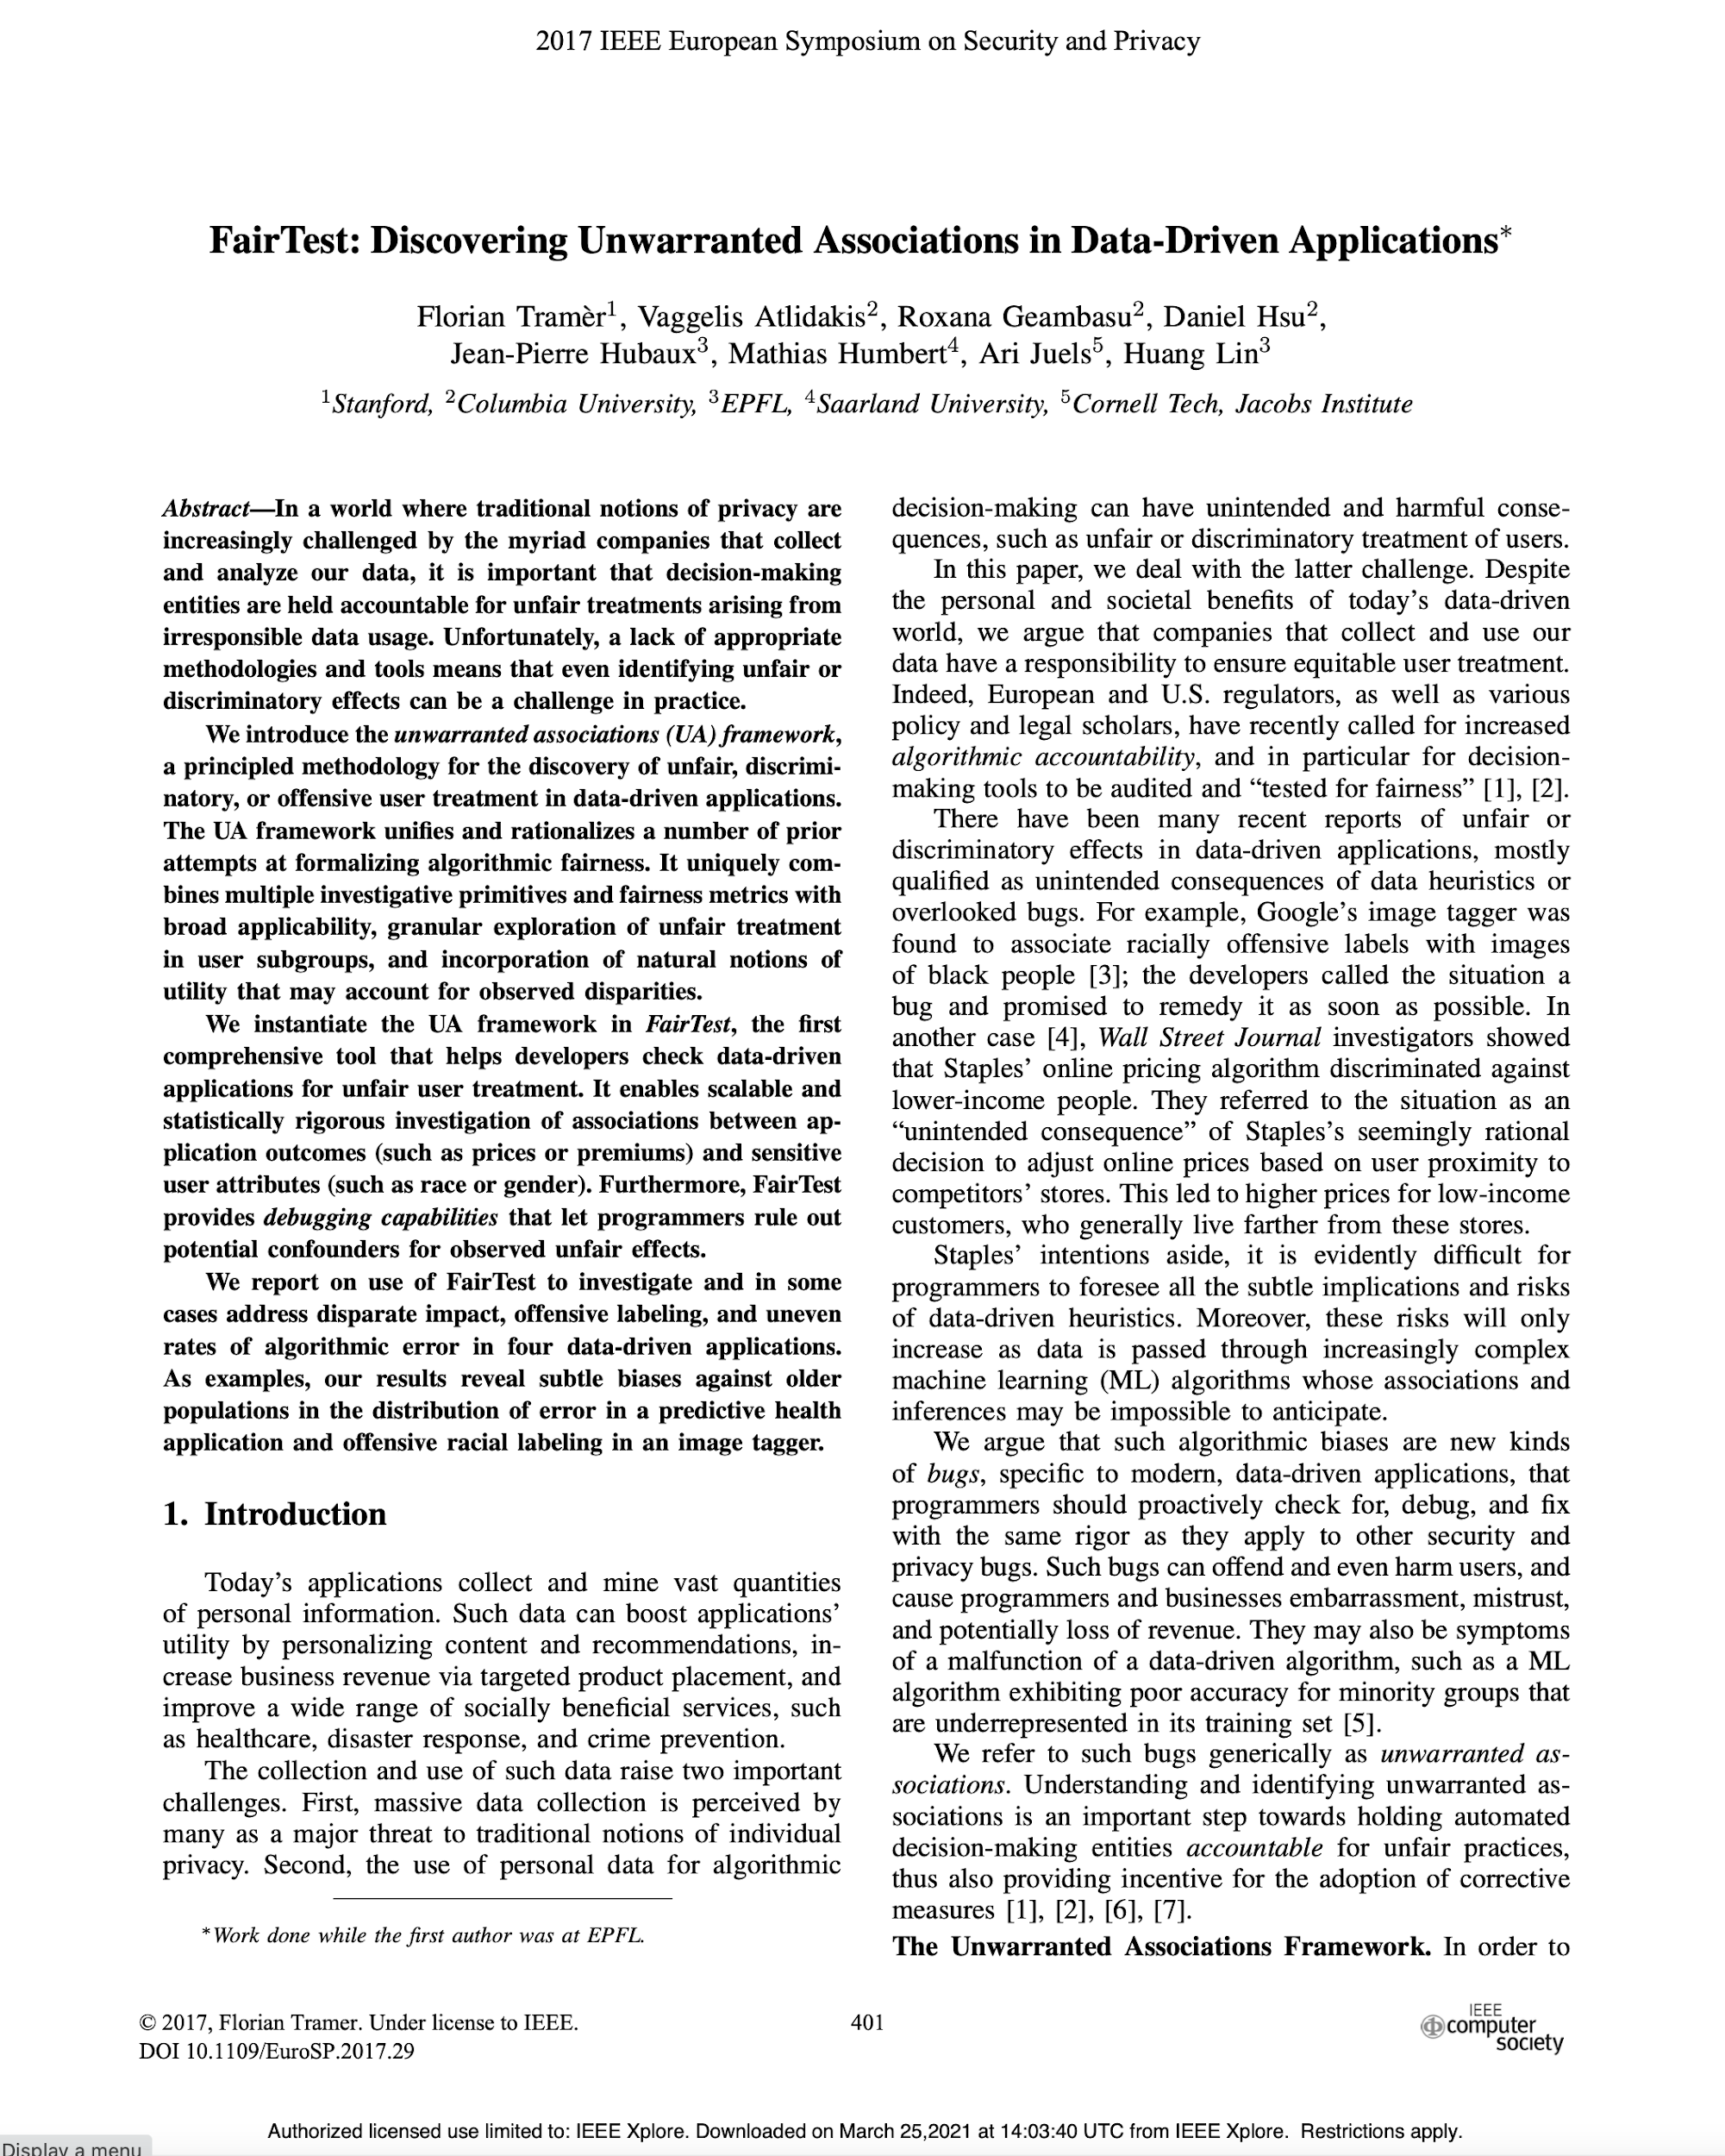
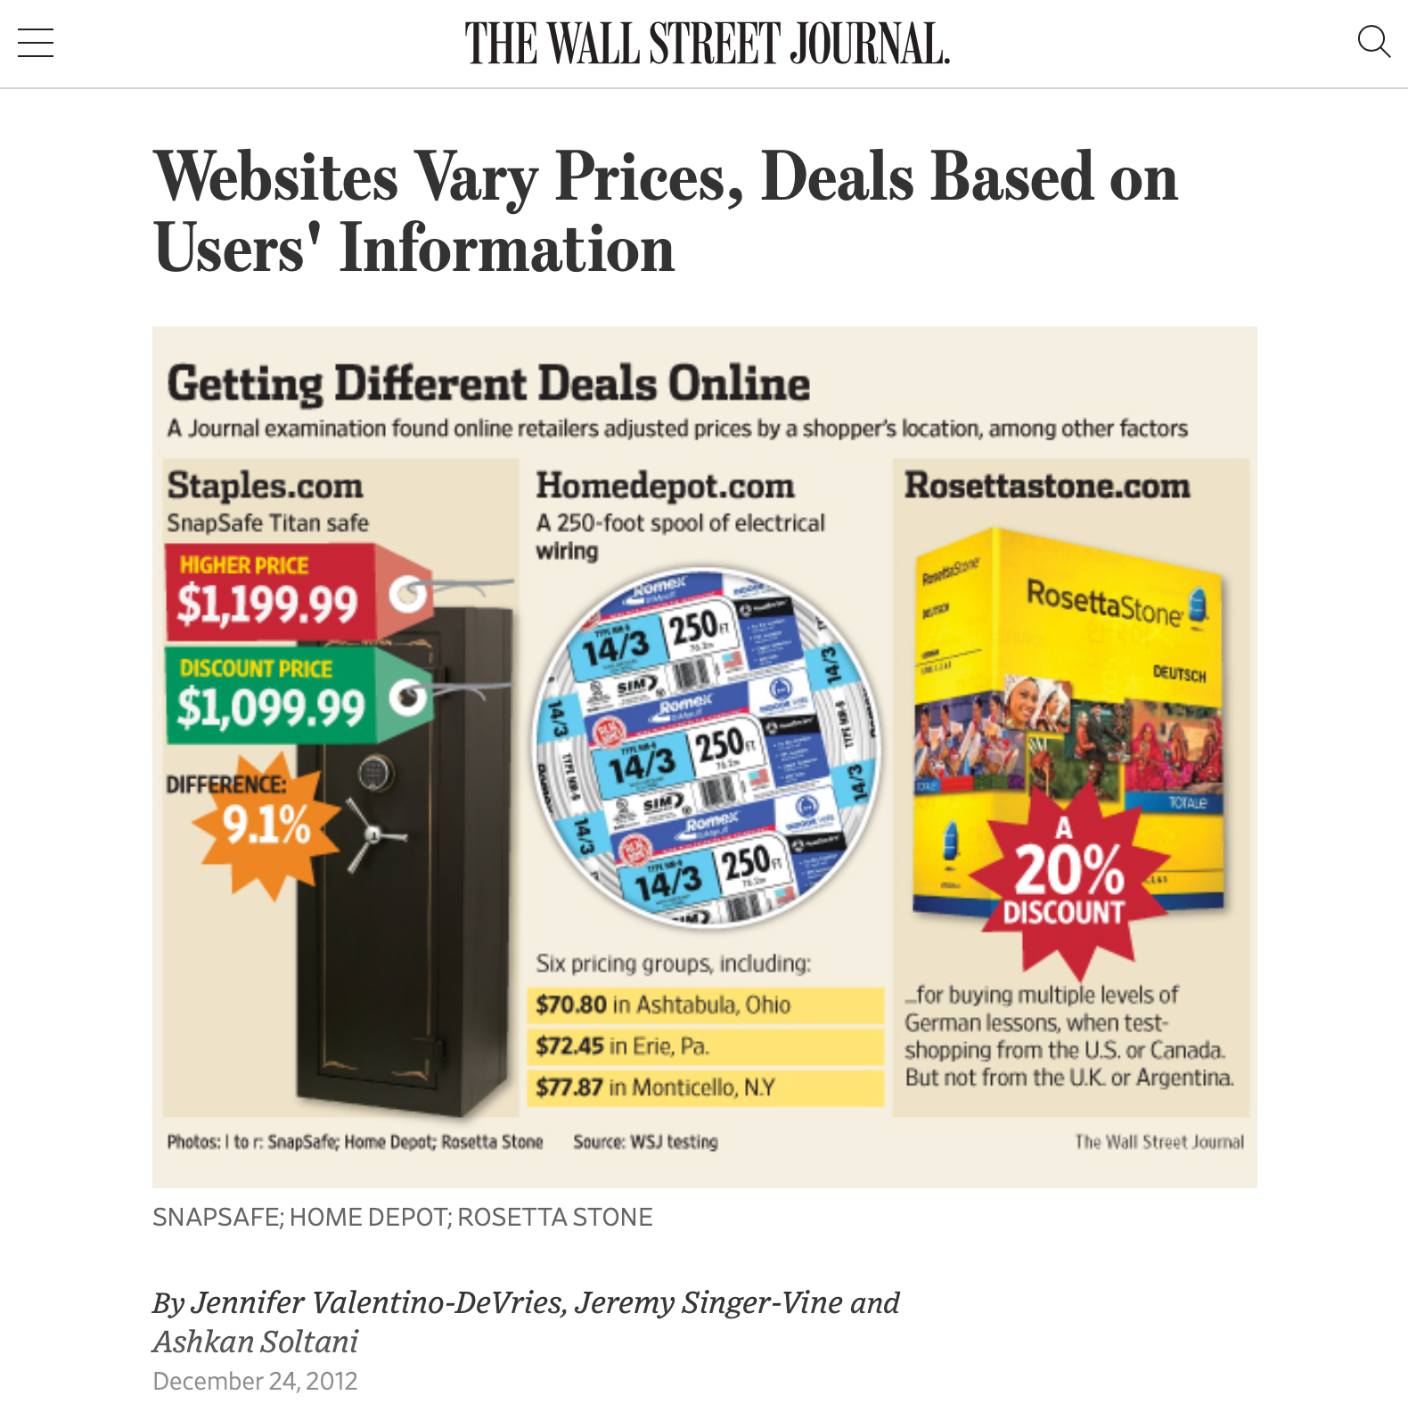
Algorithmic bias can discriminate
…against the poorest of us
https://www.wsj.com/articles/SB10001424127887323777204578189391813881534
Notes:
Algorithmic bias is all too easy to introduce - it is often easy to overlook hidden correlations between inputs that we feed into our algorithms and real world attributes. For instance: price discrimination and price steering are techniques that dynamically show a different price for the same good or service to different users. For example: Staples, OfficeMax and OfficeDepot compete to sell the same products to the same customers. If I’m Staples, and I’m trying to draw customers who might otherwise go to one of my competitors, I might say something like… “If you live within 20 miles of OfficeMax or OfficeDepot, you will see a cheaper price, otherwise you’ll see more.” This could let me drive revenues: customers who would have gone to a competitor see my low prices, customers who don’t have an alternative will pay the slightly higher price anyway.
On the surface, this sounds fine. But: what if OfficeMax + OfficeDepot are primarily located in wealthy areas? If so, then our policy is actually saying: on the whole, charge wealthy customers less than poor customers. Whether this is an OK policy or not is a topic for a class on business ethics - what our interest as software engineers is is simply in recognizing that this could be an unintended harm.

Slide 9
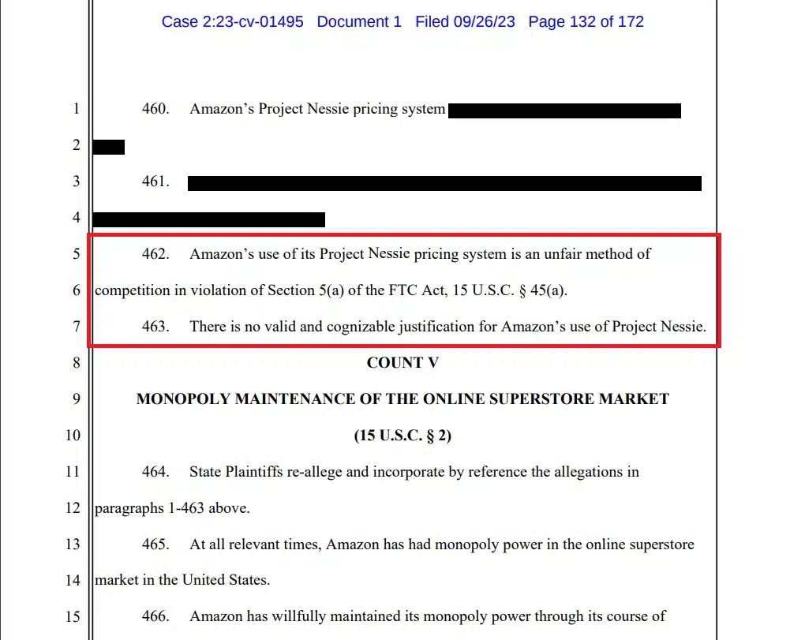
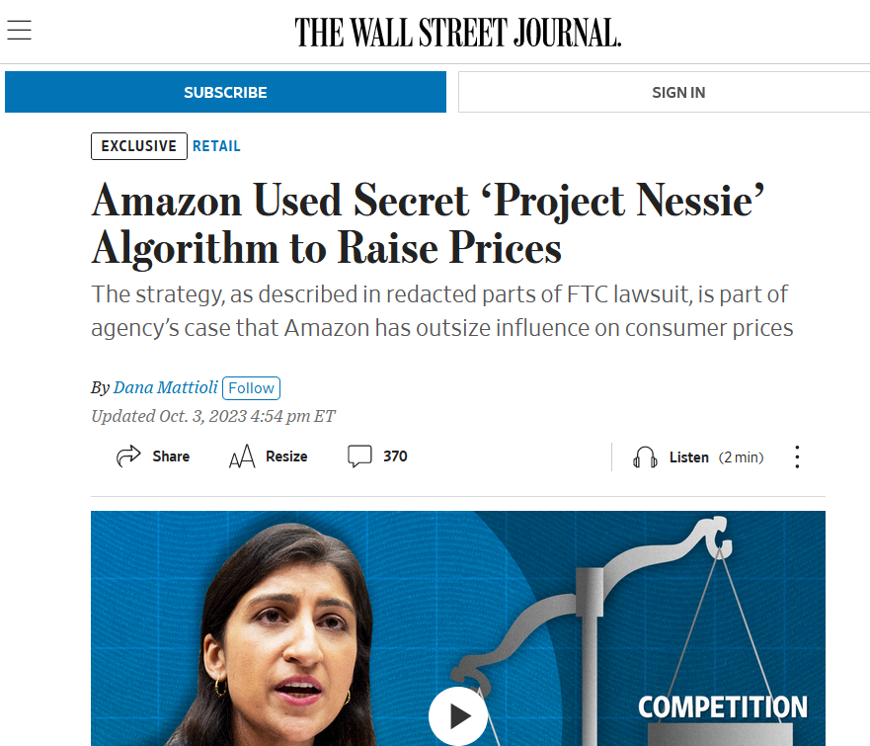
Algorithms can be used for price gouging
…against all of us
https://www.youtube.com/watch?v=T1Bcupz77-Q
https://www.wsj.com/business/retail/amazon-used-secret-project-nessie-algorithm-to-raise-prices-6c593706
Notes:
Algorithmic can also be used in price gouging

Slide 10
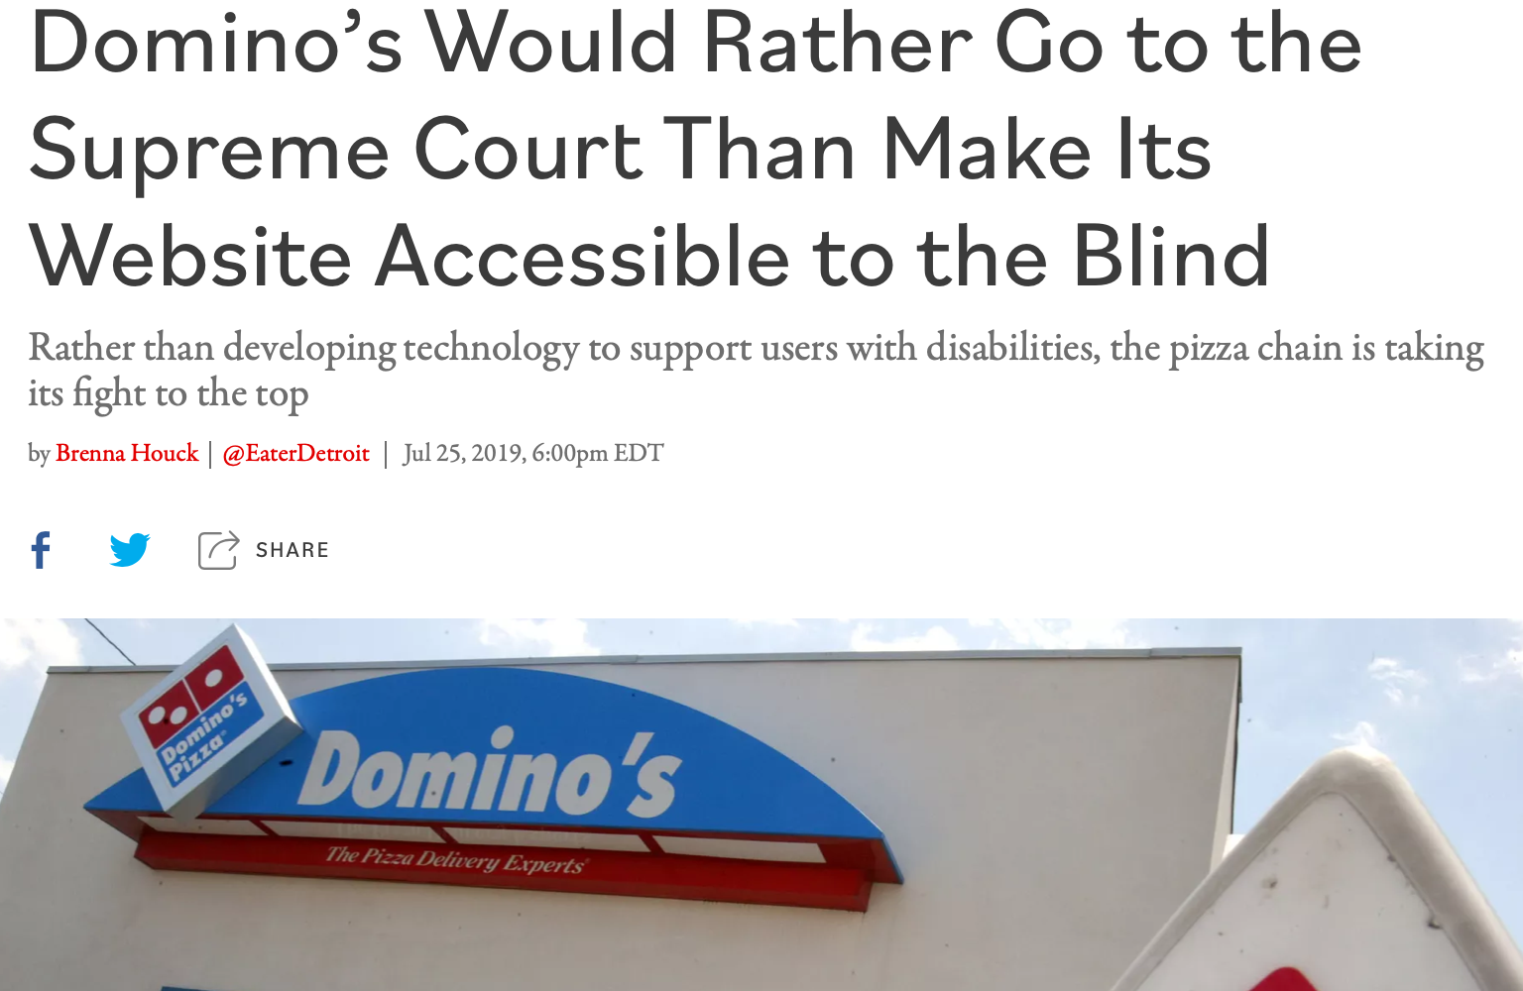
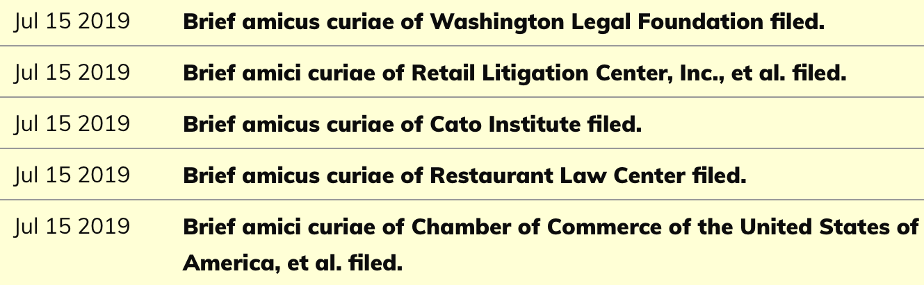
UIs can discriminate against the differently-abled
Inclusivity and Accessibility: Domino’s Pizza LLC v. Robles
“Domino’s Would Rather Go to the Supreme Court Than Make Its Website Accessible to the Blind” by Brenna Houck, Eater Detroit
Notes:
There are also very direct ways that we can inadvertently construct software that is not inclusive of all of our users. For instance: is our software accessible to users who have disabilities, such as being blind or low-vision? The Americans with Disabilities Act requires that public places must be accessible to people with disabilities. In 2019 a blind man sued Domino’s for not providing an interface for ordering pizza that was compatible with screen-readers, which is a kind of technology that is key to making computer accessible to the blind.
Dominos argued that the ADA only applies to physical interactions, since it was written before Internet, so how are we supposed to know what an accessible website is? The question brought before the supreme court, was, basically: do online retailers need to provide an accessible website? Many within the retail and restaurant industries filed amicus briefs backing Domino’s, stressing the “impossibility of guessing what accessibility means in the online environment.” The supreme court found that the ADA applies to websites, too
http://jlsp.law.columbia.edu/2020/02/13/inaccessible-pizza-delivery-and-the-future-of-the-ada/

Slide 11
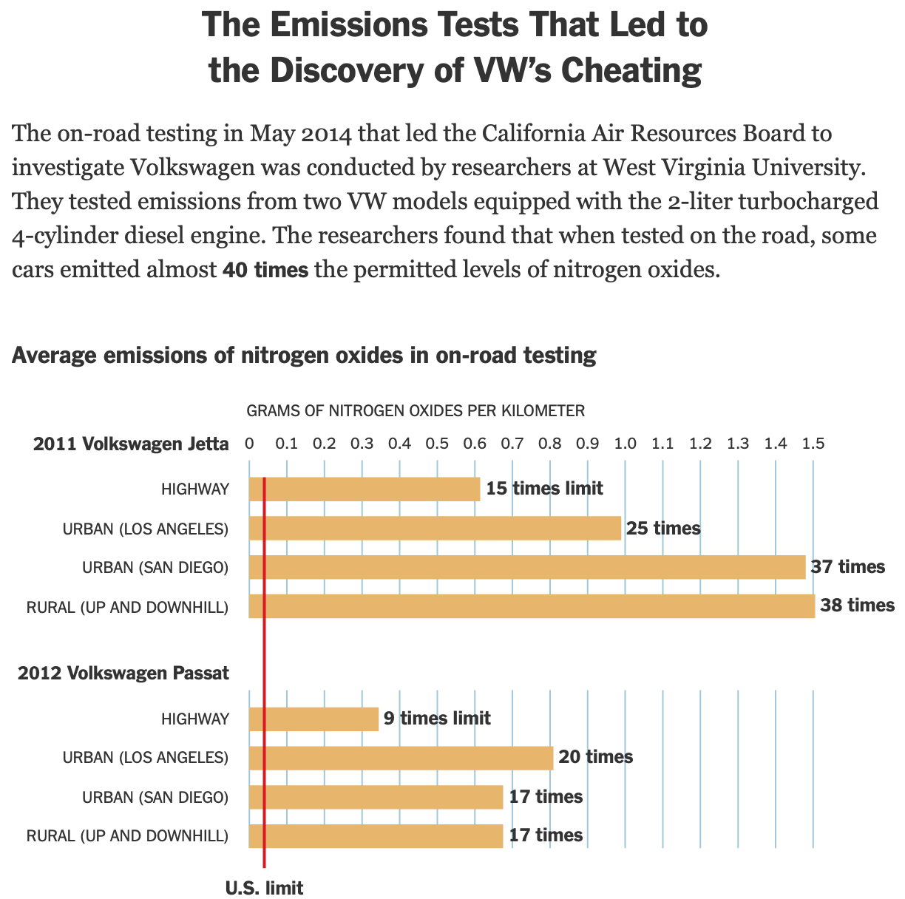
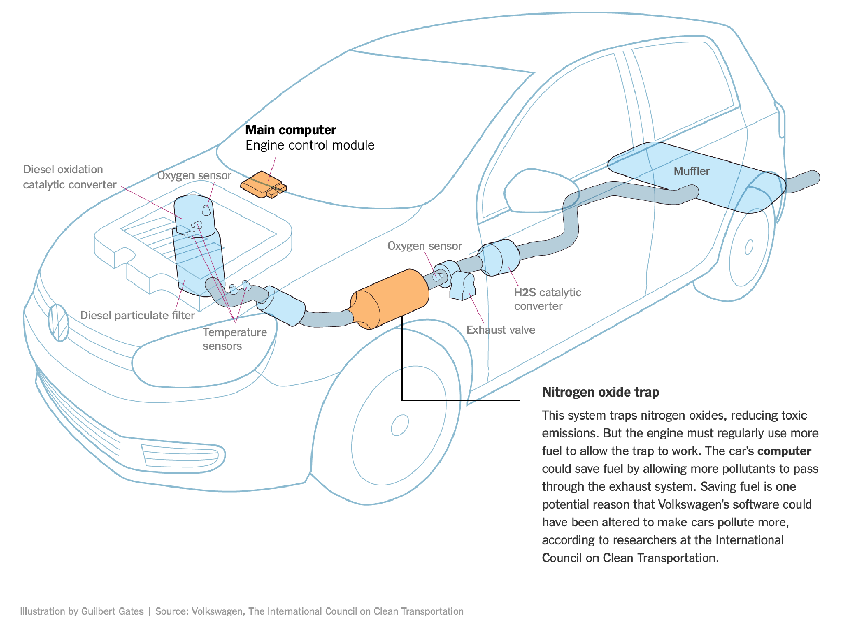
Software can help to evade regulation
Example: Volkswagen diesel emissions
$14.7 billion settlement
“How Volkswagen’s ‘Defeat Devices’ Worked” By Guilbert Gates, Jack Ewing, Karl Russell and Derek Watkins
Notes:
It’s hard to talk about engineering equitable software and not bring up the Volkswagen emissions testing defeat device. If you’re not familiar with this scandal: cars are held to a particular emissions standard. Particularly in diesel cars, reducing emissions often tracks with reducing performance. Again, the question of “how much emissions are too much, if any” is out of scope for this discussion, and instead, we’re focusing on the regulations that existed at the time of this scandal. Cars are tested for this emissions standard in off-road simulators, where they can be easily hooked up to equipment that directly measures their emissions. Volkswagen’s engine control unit had customized software to detect when the car was under an emissions test and tune the engine to reduce performance and emissions, resulting in emissions tests that significantly under-represented the actual emissions of the vehicle. (Click) This software mislead regulators and consumers, and ultimately Volkswagen agreed to spend $14.7 billion in a settlement, and was subject to significant public relations damage.

Slide 12
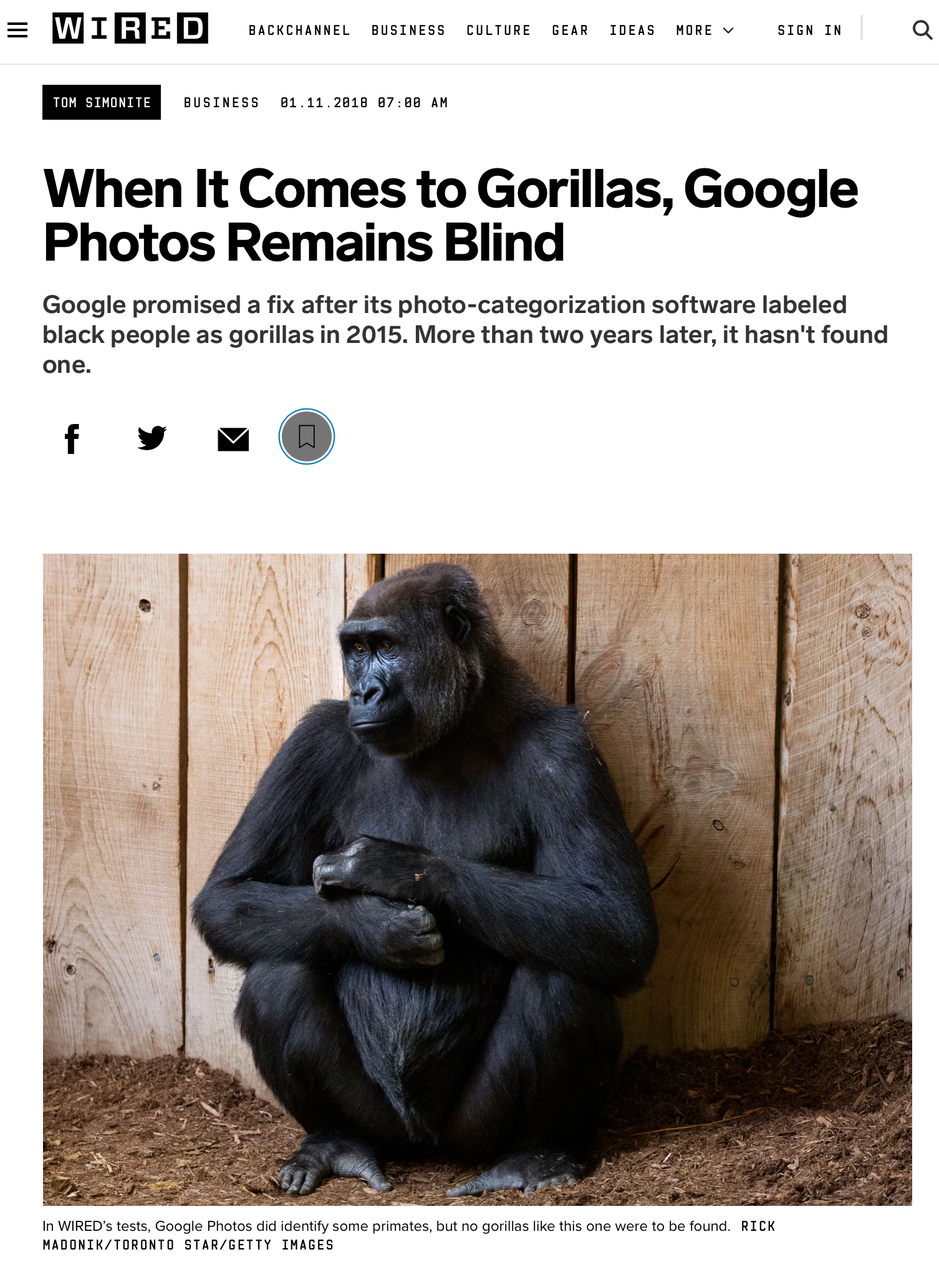
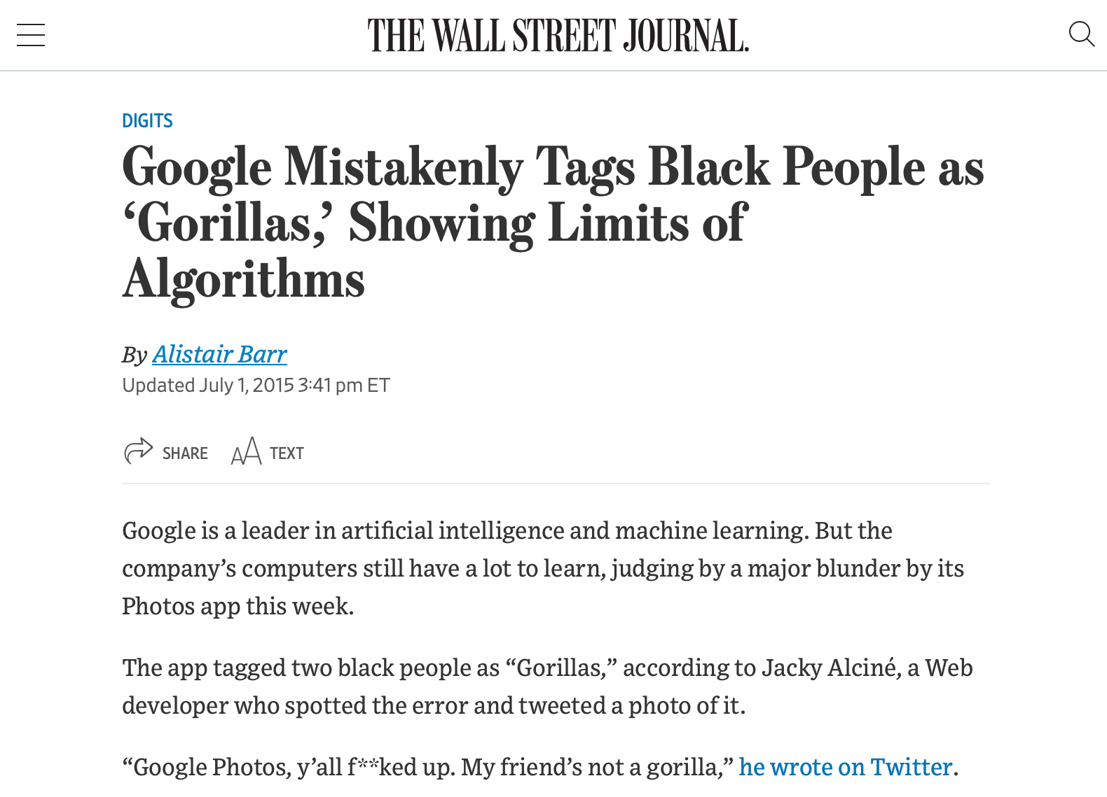
Training Data can be biased (and usually is)
Example: Google Photos auto-tagging
https://www.wsj.com/articles/BL-DGB-42522
https://www.wired.com/story/when-it-comes-to-gorillas-google-photos-remains-blind/
Notes:
As a case example of bias as the default, consider this incident from 2015, when google released a new photo tagging feature in Google Photos, which was prone to misidentify black people in photographs as gorillas. How did this happen? Image recognition algorithm depend on being supplied a proper (complete) dataset - clearly an incomplete dataset, not representative of entire population. Why didn’t this come up in internal testing? To the extent that Google has a diverse development team today, that was much less true in 2015 - so nobody was trying it and finding this out, and the unconscious bias of the organization resulted in this product getting out. This was harmful both to users, and to Google’s reputation. Even today, this is not very well fixed - and is mostly side-stepped by not identifying any image as a gorilla. It’s useful to think of a case like this to set the tone for a conversation about diversity and inclusivity, but there are many more subtle biases in our software.

Slide 13
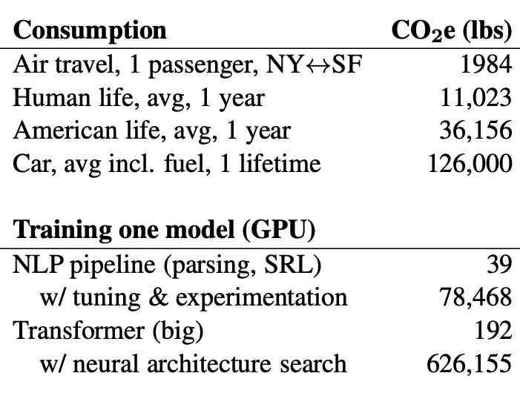
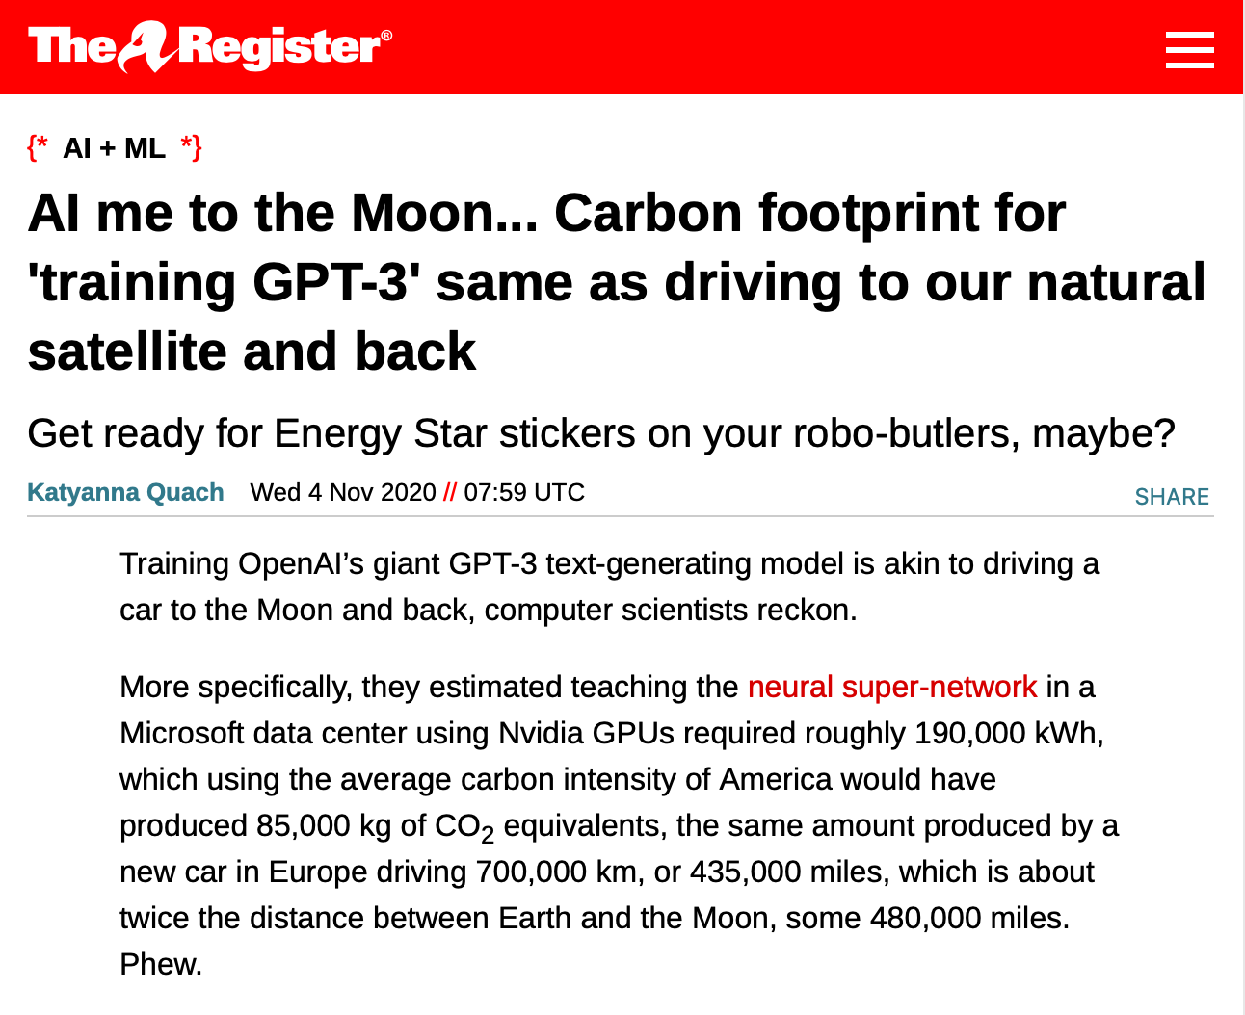
Training of AI systems can impact climate
“Energy and Policy Considerations for Deep Learning in NLP” by Strubell et al in ACL19
https://www.theregister.com/2020/11/04/gpt3_carbon_footprint_estimate/
Notes:
As we build more and more complex software and in particular, machine learning models, it is also becoming increasingly important to quantify the climate impact of our software. For example, consider training GPT-3, which is the huge text-generation model that lets gmail/google docs auto-complete your sentences and write entire documents for you. The power consumption of the training process was equivalent to driving a car for 435,000 miles. Other studies have pointed out that in training and developing models, there’s often an even greater carbon impact. Again, this is not to say that we shouldn’t create machine learning models, but rather, simply to point out that this may be an unintended harm.
Once we recognize the potential for harm, we can consider mitigation steps like locating our data centers in regions that provide for cheap renewable energy (eg solar) and cooling. (On a related application, bitcoin miners are largely located in such cheap-energy regions)

Slide 14
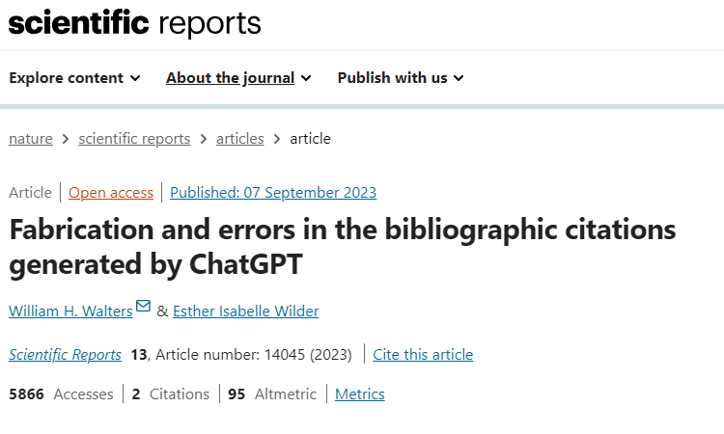
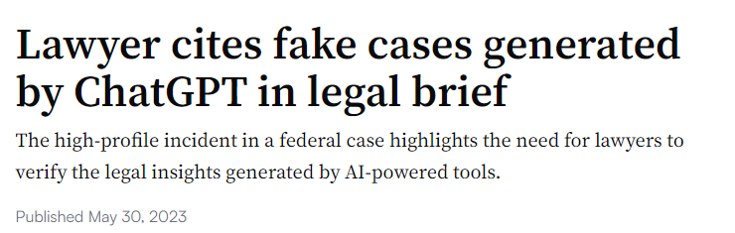
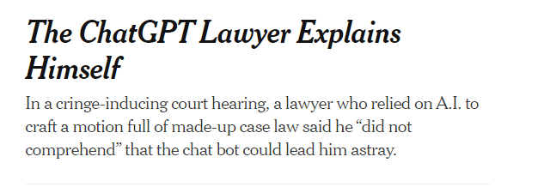
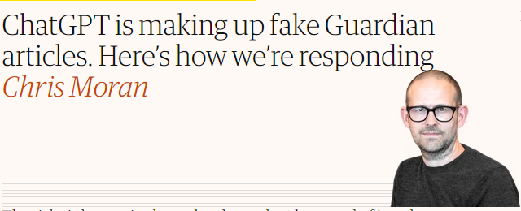
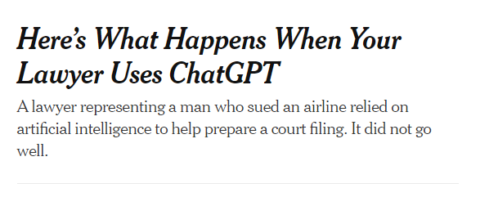
AI programs can hallucinate
Notes:
[ad lib]

Slide 15
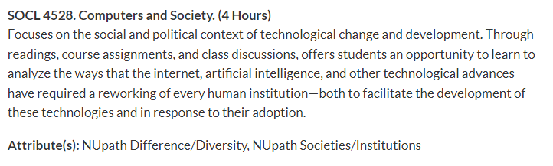
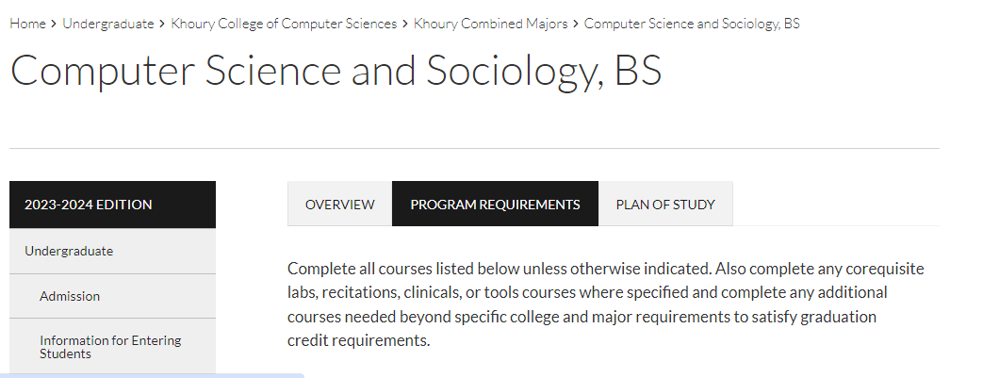
And this is only the tip of the iceberg
Other Challenges:
  interfaces and systems designed to be addictive;
  corporate ownership of personal data;
  weak cyber security and personally identifiable information (PII) protection;
  and many more …
Notes:
The more we understand the different ways in which our software affects individuals and society at large, the better we can become at avoiding or mitigating such negative effects.
Why, you could teach a whole course about it!
<click>
Or even a whole program
<click>

Slide 16
Equity and Software
As new as software engineering is, we’re newer still at understanding its impact on underrepresented people and diverse societies.
We must recognize imbalance of power between those who make development decisions that impact the world.
and those who simply must accept and live with those decisions that sometimes disadvantage already marginalized communities globally.
Quote: “Software Engineering at Google: Lessons Learned from Programming Over Time,” Wright et al, 2020 (O’Reilly)
Notes:
There is an enormous imbalance of power between those of us who make software development decisions, building software that’s used broadly, and the rest of the world that simply must accept and live with those decisions. As software engineers, you will likely wield more power than you realize.

Slide 17
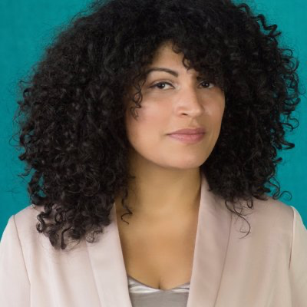
Recognize inequities in your software
One mark of an exceptional engineer is the ability to understand how products can advantage and disadvantage different groups of human beings
Engineers are expected to have technical aptitude, but they should also have the discernment to know when to build something and when not to
Demma Rodriguez
Head of Equity Engineering
Google
Quote: “Software Engineering at Google: Lessons Learned from Programming Over Time,” Wright et al, 2020 (O’Reilly)
Notes:
Being an exceptional engineer means not only that you know HOW to build some great features, but that you have the judgement to be able to identify and reject features or products that drive adverse outcomes.

Slide 18
More than don’t be evil
Engineering equitable software requires conscious effort
  How do we determine what “the right thing” is?
  How do we weigh competing interests and values
  How do we convince our investors/managers to take this action?
Notes:
Engineering equitable software requires conscious effort. It is not simple enough to take on a motto like “don’t be evil” or “do the right thing,” when it is often difficult to fully comprehend the societal impacts of our technical decisions. Any piece of software, or any feature can have both good and bad impacts. Moreover, even when we do see a clear potential harm to some portion of the population, taking corrective action can be challenging.

Slide 19
An approach: consider human values in the design process.
Technology is the result of human imagination
All technology involves design
All design involves choices among possible options
All choices reflects values
Therefore, all technologies reflect and affect human values
Ignoring values in the design process is irresponsible
Engaging with values in the design process offers creative opportunities for:
  Technical innovation
  Improving the human condition (doing good and saving the world)
Notes:
Ethics here is not about not doing terrible things. The assumption is that you are not evil.
The problem is how to be successful at doing good things (e.g. preventing election manipulation, improving education outcomes), as well as avoiding doing things that appear fine but turn out to be problematic (e.g. that violate privacy or exacerbate injustices)

Slide 20
Technological Success takes a broader view
In CS, we typically think about technical success
Maybe we should think about technological success
  Does the technology function?
  Does it achieve first-order objectives?
Example metrics:
  Test coverage and bug tracker
  Crash reports
  Benchmarks of speed, prediction accuracy, etc.
  Counts of app installations, user clicks, pages viewed, interaction time, etc.
  Is the technology beneficial to stakeholders, society, the environment, etc.?
  Is the technology fair or just?
Example metrics:
  Assessments of quality of life
  Measures of bias
  Reports of bullying, hate speech, etc.
  Carbon footprint
Notes:
Here "technological success" is intended to mean taking a broader view of the technology and its impact on society.
<read slide>

Slide 21
Challenges: how to
  Define success objectives?
  Identify the social structure in which a technology is situated?
  Identify legitimate direct and indirect stakeholders?
  Elicit the full range of values at play?
  Balance and address tensions between different values?
  Identify and mitigate unintended consequences?
Notes:
<read slide>

Slide 22
Identifying Stakeholders
Direct Stakeholders
Indirect Stakeholders
The sponsor (your employer, etc.)
Members of the design team
Demographically diverse users
  Races and ethnicities, men and women, LGBTQIA, differently abled, US vs. non-US, …
Special populations
  Children, the elderly, victims of intimate partner violence, families living in poverty, the incarcerated, indigenous peoples, the homeless, religious minorities, non-technology users, celebrities
Roles
  Content creators, content consumers, power users, …
Bystanders
  Those who are around your users
  E.g. pedestrians near an autonomous car
“Human data points”
  Those who are passively surveilled by your system
Civil society
  E.g. people who aren’t on social media are still impacted by disinformation
  People who care deeply about the issues or problem being addressed
Those without access
  Barriers include: cost, education, availability of necessary hardware and/or infrastructure, institutional censorship…
Whose values are impacted by a piece of technology?
Notes:
<summarize/read slide>

Slide 23
Filtering Stakeholders
It is tempting to be overly comprehensive when enumerating stakeholders…
But not every impacted individual has legitimate values at play
Examples:
  Foreign election meddlers are affected by content moderation, want to protect their “free speech”
  Dictatorships are impacted by universal encryption, want unfettered surveillance capabilities
  Cyber criminals want to steal things, are against cybersecurity measures
These stakeholders are not legitimate, may be safely ignored
Notes:
OTOH, if the goals of the stakeholder are illegal or unethical, they do not merit consideration.

Slide 24
Identifying the Full Range of Values
Some values are universal: accessibility, justice, human rights, privacy
Others are tied to specific stakeholders and social contexts
Identifying relevant values:
  Start with a thorough understanding of the relevant features of the social situation
  Add experience/knowledge from similar technologies or design decisions (case studies, etc.)
  Add results of empirical investigation
What are the scale of impacts to various stakeholders?
Notes:
If we are going to consider human values when designing software, we first need to better understand what values we are talking about.

Slide 25
Example Values
Human welfare refers to people’s physical, material, and psychological well-being
Accessibility refers to making all people successful users of information technology
Respect refers to treating people with politeness and consideration
Calmness refers to a peaceful and composed psychological state
Freedom from bias refers to systematic unfairness perpetrated on individuals or groups, including pre-existing social bias, technical bias, and emergent social bias
Notes:
<Read or excerpt from slide>
<Pause to give students a chance to read the slide>

Slide 26
More Example Values
Ownership and property refers to a right to possess an object (or information), use it, manage it, derive income from it, and bequeath it
Privacy refers to a claim, an entitlement, or a right of an individual to determine what information about himself or herself can be communicated to others
Trust refers to expectations that exist between people who can experience good will, extend good will toward others, feel vulnerable, and experience betrayal
Accountability refers to the properties that ensures that the actions of a person, people, or institution may be traced uniquely to the person, people, or institution
Notes:
<Read or excerpt from slide>
<Pause to give students a chance to read the slide>

Slide 27
Addressing Value Tensions
This is where the hard choices happen
What are the core values that cannot be violated?
Which tensions can be addressed through:
  Technological mechanisms?
  Social mechanisms?
When a tension cannot be reconciled, whose values take precedence?
What tensions must be addressed immediately, versus later on through additional features?
  Early design decisions will unavoidably foreclose future design possibilities
Stakeholders
Values
Value Tensions
Design Trade-offs
Notes:
What happens when vales are in conflict?

Slide 28
Identifying Unintended Consequences
Technology will be adopted in unanticipated ways. Being intellectually rigorous means considering and mitigating risks in designs ahead of time.
What if:
  Our recommendation system promotes misinformation or hate speech?
  Our database is breached and publicly released?
  Our facial recognition AI is used to identify and harass peaceful protestors?
  Our child safety app is used to stalk women?
  Our chatbot is sexist or racist?
Notes:
Hard to not do evil when you’re building powerful tools. <read slide>

Slide 29
Example 1: Content Moderation
The issue: free expression in tension with welfare and respect
  Some speech may be hurtful and/or violent
  Removing this speech may be characterized as censorship
Bad take: unyielding commitment to free speech, no moderation
  Trolls and extremists overrun the service, it becomes toxic, all other users leave
  Violent speech actually impedes free speech in general
Bad take: strict whitelists of acceptable speech
  Precludes heated debate, discussion of “sensitive topics”
  Disproportionately impacts already marginalized groups
Good take: recognizing that moderation will never be perfect, there will be mistakes and grey areas
  Doing nothing is not a viable option
  Clear guidelines that are earnestly enforced create a culture of accountability
Notes:
<Read slide>
Note that this is not only about the design of the software. It's about how it is deployed and administered.

Slide 30
Example 2: Image Generation
AI text-to-image generators have a well-documented bias problem. AI models are trained on images from the internet, so bias in, bias out. A recent experiment from Bloomberg on the image generator Stable Diffusion found that AI portraits of architects, doctors and CEOs skewed white and male, while images of cashiers and housekeepers skewed towards women of color.
Adobe’s solution to the bias issue was to use data that estimates the skin tone distribution of a Firefly user’s country, and apply it randomly to any human Firefly creates. In other words, if someone in the U.S. used Firefly to make an image of a doctor or a gardener, the chances that person would be a woman or have non-white skin would be roughly proportional to the percentage of women and people of color in the U.S.
In Firefly world, about 14% of doctors should be Black — the same percentage as the Black population in the U.S. But in the messy, unequal real world, only 6% of doctors are Black.
So, should AI images depict the world as it is? Or as it should be?
“That becomes almost like a philosophical question,” said Rumman Chowdhury, a Responsible AI Fellow at Harvard’s Berkman Klein Center for Internet and Society.
https://www.marketplace.org/2023/10/10/solutions-to-ai-image-bias-raise-their-own-ethical-questions/

Slide 31
Strategies for Addressing Value Tensions
Identify Red Lines
Red lines: bedrock values that cannot be violated
Address these first
Look for Win—Wins
Look for win-win scenarios
Some stakeholders may be agreement; others may want the same outcome but for different reasons
Embrace Tradeoffs
Be open and honest when value tradeoffs are necessary
e.g. when functionality and privacy are in tension, both can be addressed through informed consent
Don’t Forget Social Solutions
Creatively leverage technical and social solutions in concert
e.g. if a new system is going to automate away jobs, pair it with a retraining program
Notes:
Here are some strategies for discussing value tensions. <read slide>

Slide 32
Practical Tips
Adopt, Extend, Adapt
Adopt and extend the methods for your own purposes. Adapt for your sociotechnical setting.
Variety
Use a variety of empirical values-elicitation methods, rather than relying on a single one.
Continuous Evaluation
Continue to elicit stakeholder values throughout the design. If new values of import surface during the design process, engage them.
Anticipation
Anticipate unanticipated consequences: continue the process throughout the deployment of the technology
Collaborate
Particularly with people from other disciplines, and those with deep contextual knowledge of and expertise in your sociotechnical setting.
Notes:
Here are some more buzzwords to think about when planning a discussion about values in software.

Slide 33
Where does this leave us?
So that we can sleep at night
  Consider the different ways that our software may impact others
  Consider the ways in which our software interacts with the political, social, and economic systems in which we and our users live
  Follow best practices, and actively push to improve them
  Encourage diversity in our development teams
  Engage in honest conversations with our co-workers and supervisors to explore possible ethical issues and their implications.
Notes:
There’s no silver bullet for ethical software development. However, hopefully now you understand better the different ways that our software can have impacts on others, and how we can reason about those implications. We have talked about understanding users’ needs better which can be helpful in making better decisions

Slide 34
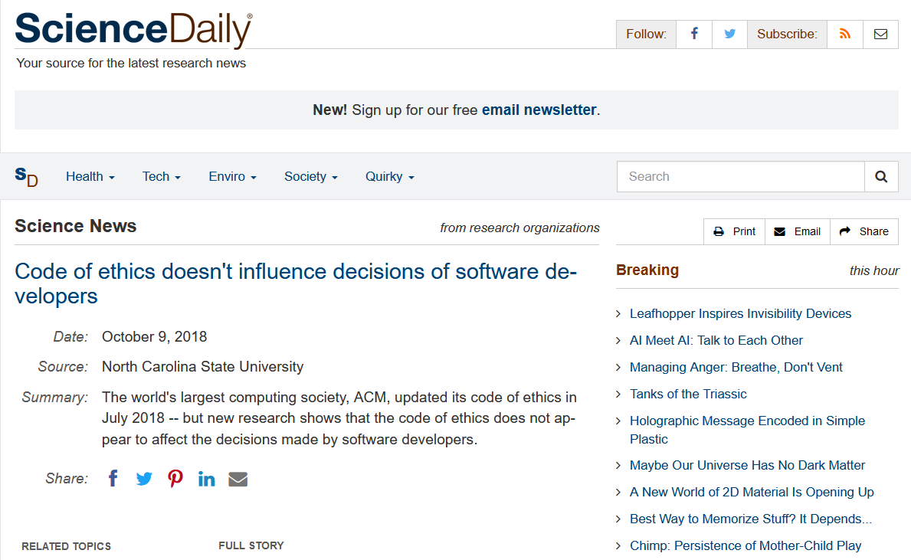
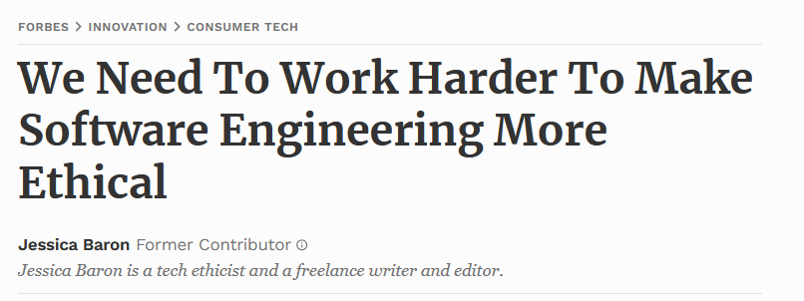
There is a lot more work to be done
Current Challenges:
  addictive design;
  corporate ownership of personal data;
  algorithmic bias;
  weak cyber security and personally identifiable information (PII) protection;
  overemphasis on features
  and many more …
https://www.sciencedaily.com/releases/2018/10/181009113617.htm
https://www.forbes.com/sites/jessicabaron/2018/10/17/we-need-to-work-harder-to-make-software-engineering-more-ethical/?sh=628d00a750cc
Notes:
There’s no silver bullet for ethical software development. However, hopefully now you understand better the different ways that our software can have impacts on others, and how we can reason about those implications. We have talked about understanding users’ needs better which can be helpful in making better decisions

Slide 35
Review
You should now be able to…
  Illustrate how software can cause inadvertent harm or amplify inequities
  Explain the role of human values in designing software systems
  Explain some techniques that software engineers can use in producing software systems that are more congruent with human values.

